Slide 1
Project Lombok

Slide 2
Project Lombok
Learning Objectives:
By the end of this section, learners will be able to:
Describe the Project Lombok library and its advantages.
Remove the boilerplate code and save the precious time of developers during development by just using some annotations
Use Project Lombok with Spring boot application.

Slide 3
Table of Contents
Overview of Project Lombok.
How Project Lombok Works.
Project Lombok Maven Dependencies.
Important Annotations from Lombok
Lombok - @Getter and @Setter Annotation.
Lombok - @Tostring Annotation.
Lombok - Constructor Annotations.
Lombok - @Data for Additional Methods.

Slide 4
Overview of Project Lombok
Project Lombok is a Java library capable of minimizing code. The library replaces boilerplate code with easy-to-use annotations. With Lombok plugin, you do not have to worry about writing getters, setters, constructors, hashcode, equals, toString methods, and other boilerplate items that you have to write in Java classes.
Annotation processors: Lombok works by using annotation processors, which are components of the Java compiler that process annotations and generate additional code based on those annotations. When you build your project, the Lombok annotation processor will run and generate the necessary code for you.
IDE support: Lombok integrates with popular Java IDEs and provides plugins that allow you to use Lombok annotations with full support from your IDE. This means that your IDE will recognize Lombok annotations and provide code completion, syntax highlighting, and other features for them.
Notes:
Note: Lombok makes heavy usage of its own internal APIs for configuring the compiler. So you must be aware that upgrading your compiler might break your code. But, by saying so, Lombok being a matured tool with huge adoption, the probability is pretty low.

Slide 5
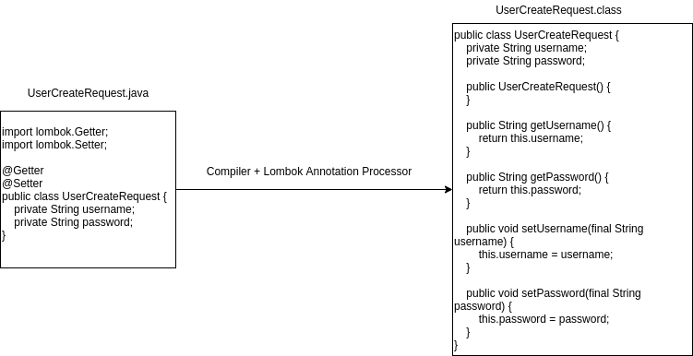
How Project Lombok Works
Project Lombok is an annotation processor, which works on compile time to add codes into classes (added in Java 5). If we use any type of annotation processor, the compiler comes to that level when compiling the class, and is given control to that specific processor to process and do what is needed for that class.
Let’s think we added @Getter and @Setter annotation from Lombok to any class. While compilation is happening, the compiler gives the Lombok annotation processor a chance to add whatever things needed to be added inside the class.
Notes:
https://howtodoinjava.com/lombok/lombok-eclipse-installation-examples/

Slide 6
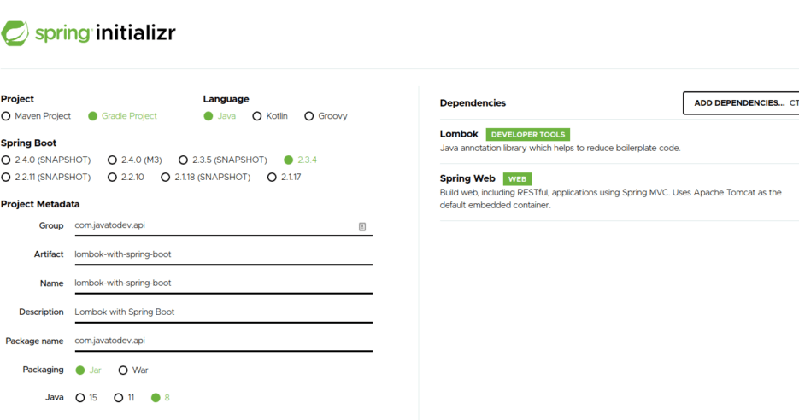
Project Lombok Maven Dependencies
If you are creating new Spring boot project using Spring Initializr, you can add Project Lombok dependencies as shown in the screenshot below:
If you need to add lombok manually in your project, add the below lombok dependency to the Maven POM (pom.xml).
<dependency> <groupId>org.projectlombok</groupId>
<artifactId>lombok</artifactId>
<version>1.18.20</version>
<scope>provided</scope>
</dependency>
Click here to review the Maven website.

Slide 7
Important Annotations from Lombok
Some of the key features and annotations provided by Lombok include:
@Getter and @Setter:
Automatically generates getter and setter methods for class fields.
@ToString:
Generates a toString() method for the class, including all its fields.
@EqualsAndHashCode:
Generates equals() and hashCode() methods based on the class fields.
@Builder:
Simplifies the creation of builder patterns for complex object creation.
@Slf4j:
Integrates with SLF4J logging, providing a logger field in the class.

Slide 8
Important Annotations from Lombok (continued)
@Value:
Similar to @Data, but treats the class as immutable, generating final fields and removing setters.
@Cleanup:
Automatically closes resources (like streams) when they go out of scope.
@NoArgsConstructor, @RequiredArgsConstructor, and @AllArgsConstructor:
Generate constructors with no arguments, constructors with required arguments, and constructors with all arguments, respectively.
@Data:
Combines the functionality of @Getter, @Setter, @ToString, @EqualsAndHashCode, and @RequiredArgsConstructor in a single annotation.

Slide 9
Lombok - @Getter and @Setter Annotation
Traditional Way
We use getters and setters to achieve the encapsulations in Java. We declare variables/attributes as private, and provide public methods to access and update those private variables:
public class UserCreateRequest {
private String username;
private String password;
public String getUsername() {
return username;
}
public void setUsername(String username) {
this.username = username;
}
public String getPassword() {
return password;
}
public void setPassword(String password) {
this.password = password;
}
}
Lombok way (using @Getter and @Setter)
We can write the same class using Lombok with fewer codes:
import lombok.Getter;
import lombok.Setter;
@Getter
@Setter
public class UserCreateRequest {
private String username;
private String password;
}
We can use @Getter and @Setter annotations at the class level. Lombok generates getter and setter methods for all the fields.
Notes:
Lombok issues with first char lowerCase and next upperCase. There is a known issue with Lombok, where that Lombok generates wrong getter and setter for variable/attributes which named as first char lowerCase and next char upperCase.

Slide 10
Lombok - @ToString Annotation
The @ToString annotation in Lombok is used to automatically generate a toString() method for a class. This method produces a human-readable string representation of the object's state, including the values of its fields.
Traditional Way
Lombok way (using @ToString)
public class Person {
private String firstName;
private String lastName;
private int age;
public Person(String firstName, String lastName, int age) {
this.firstName = firstName;
this.lastName = lastName;
this.age = age;
}
// Manual implementation of toString() method
public String toString() {
return "Person{" +
"firstName='" + firstName + '\'' +
", lastName='" + lastName + '\'' +
", age=" + age +
'}';
}
// Getters and setters...
}
import lombok.ToString;
@ToString
public class Person {
private String firstName;
private String lastName;
private int age;
// Lombok generates the no-argument constructor
// Getters and setters...
}
Notes:
By default It will not include any static field in the implementation of toString(). Further, we can exclude the specific field in the implementation of toString() by using optional parameter ‘exclude’.

Slide 11
Lombok - Constructor Annotations
@NoArgsConstructor: Use the @NoArgsConstructor annotation to generate the default constructor that takes no arguments.
@AllArgsConstructor: Use the @AllArgsConstructor to generate a constructor with arguments for all the variable/attributes.
import lombok.*;
//@NoArgsConstructor annotation for generating a constructor with no parameters
//@AllArgsConstructor annotation for generating a constructor with parameter for each field
@NoArgsConstructor
@AllArgsConstructor
public class ConstructorUserDemo {
private int userId;
private String userName;
private int userAge;
}

Slide 12
Example - Lombok
Step 1: Before using Lombok, you need to ensure that the Lombok library is added to your project. This can be done by using a build tool like Maven..
Step 2: Let's create a Person class with Lombok annotations.
import lombok.Getter;
import lombok.Setter;
import lombok.ToString;
import lombok.NoArgsConstructor;
@Getter
@Setter
@ToString
@NoArgsConstructor
public class Person {
private String firstName;
private String lastName;
private int age;
}
In this example:
@Getter: Automatically generates getter methods for all fields.
@Setter: Automatically generates setter methods for all fields.
@ToString: Generates a toString() method including all fields.
@NoArgsConstructor: Generates a no-argument constructor.
Notes:
This example demonstrates how Lombok annotations can significantly reduce the boilerplate code in your Java classes, making them more concise and readable.

Slide 13
Example - Lombok (continued)
Step 3: Use the Lombok-Annotated Class:
Create a class named LombokExample with main() method, in this class we will use the Person class, as shown in the code on right side.
public class LombokExample {
public static void main(String[] args) {
// Create a new Person object using the generated no-argument constructor
Person person = new Person();
// Set values using the generated setter methods
person.setFirstName("John");
person.setLastName("Doe");
person.setAge(30);
// Print the object using the generated toString() method
System.out.println("Person details: " + person.toString());
}
}

Slide 14
Example - Lombok (continued)
Step 4: Run the Program:
Run the LombokExample program, and you should see the similar output as shown below:
Person details: Person(firstName=John, lastName=Doe, age=30)

Slide 15
Lombok @Data for Additional Methods
@Data annotation is more powerful than just using Getter and Setter alone; @Data annotation comes with the following additional auto-generated methods:
RequiredArgsConstructor – Generates a constructor with required arguments.
ToString – Useful to String method.
EqualsAndHashCode – Has hashcode and equals implementation that check all non-transient fields.
@Data is a convenient annotation that combines the features of the following annotations:
@ToString
@EqualsAndHashCode
@Getter
@Setter
@RequiredArgsConstructor
Example usage of @Data for a class.
import lombok.Data;
@Data
public class BooksResponse {
private String bookIsbn;
private String authorName;
private Double netPrice;
}

Slide 16
Knowledge Check
Describe Project Lombok.
What are the benefits of Project Lombok?

Slide 17
Summary
Project Lombok is a Java library that automatically plugs into your editor and build tools, spicing up your java. Never write another getter or equals method again. With one annotation, your class has a fully featured builder, automates your logging variables, and much more.

Slide 18
References
https://www.javanibble.com/how-to-use-the-builder-annotation-of-project-lombok/

Slide 19

End of Section
All trademarks, service marks, and trade names in this course are the marks of the respective owner(s).

